Slide 1
Photomicrographs of Plant Seeds
Raspberry
Permission to reproduce original photomicrographs used to make this collection may be obtained from
Dr. David O. Norris at
david.norris@colorado.edu

Slide 2
10X
25X
Raspberry seed
Notes:
S49. Raspberry, American red; seed [Rubus coronarius (Sims) Sweet]. Compare to blackberry. Actually numerous hydrid forms; R. delicious is the wild species found in the Rocky Mountains.

Slide 3
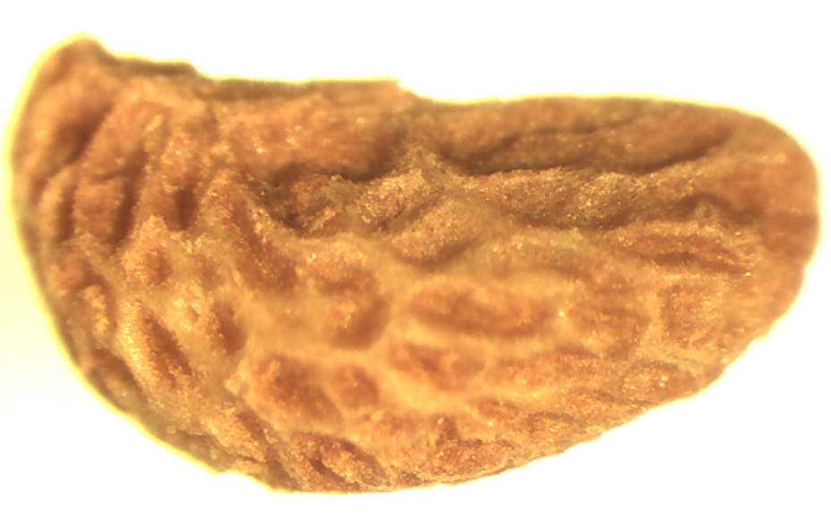
25X
Raspberry seed
Notes:
S50. Raspberry, American red; seed [Rubus coronarius (Sims) Sweet]. Compare to blackberry. Actually numerous hydrid forms; R. delicious is the wild species found in the Rocky Mountains.

Slide 4
A
B
Raspberry seed
Notes:
S51. Raspberry, American red; seed [Rubus coronarius (Sims) Sweet], fresh. SEM. A. Seed. B. Seed texture. SEMs prepared by Dr. Patrick Kociolek and Joshua Stepanek.

Slide 5
A
B
Raspberry seed
Notes:
S52. Raspberry seed, dried for several years. SEM. A. Seed. B. Seed coat texture. SEMs prepared by Dr. Patrick Kociolek and Joshua Stepanek.

